Slide 1
Percentages, Decimals and Rounding
By Hurles

Slide 2
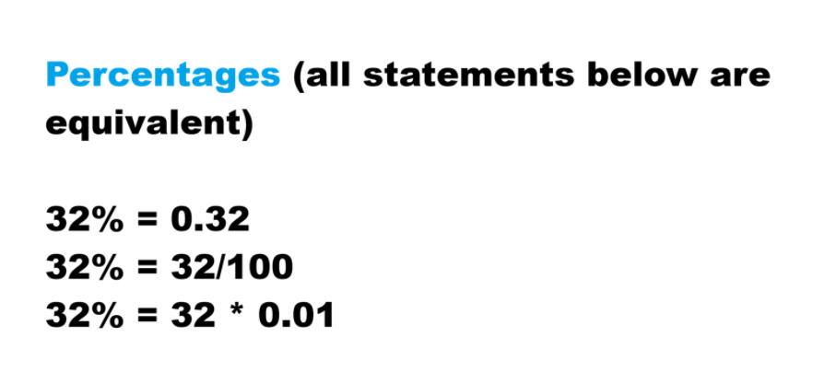

Slide 3
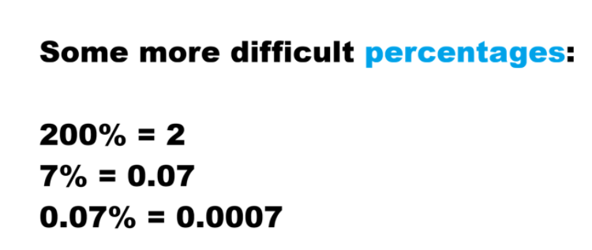

Slide 4
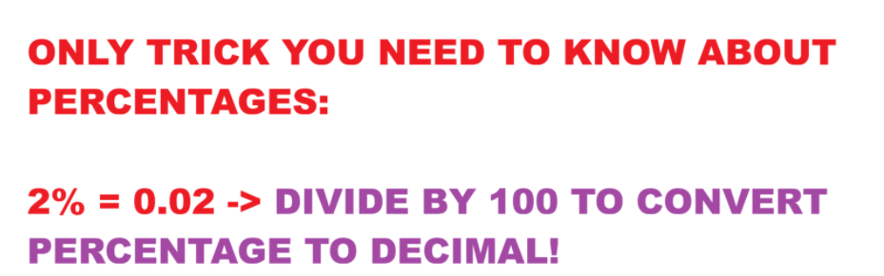

Slide 5
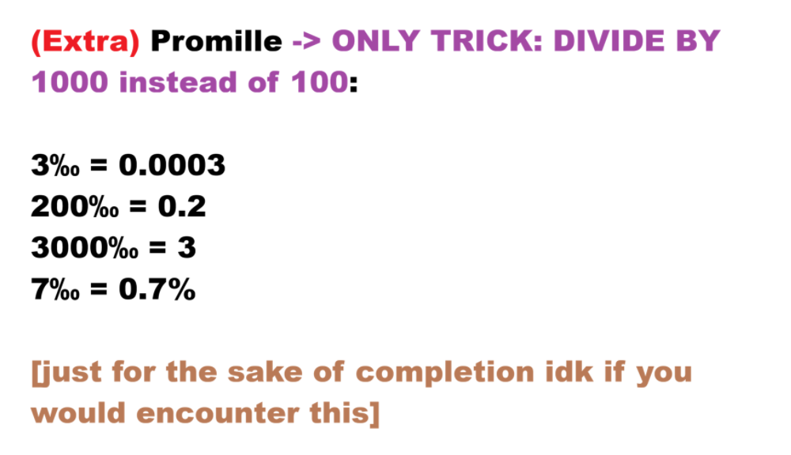

Slide 6
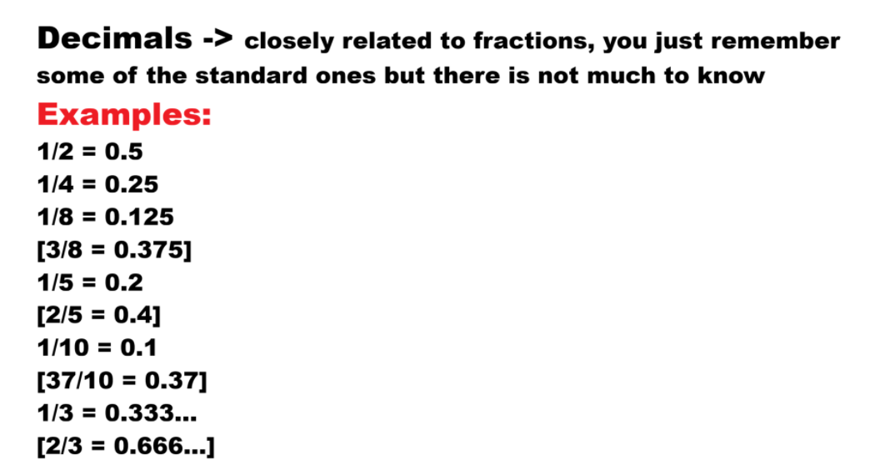

Slide 7
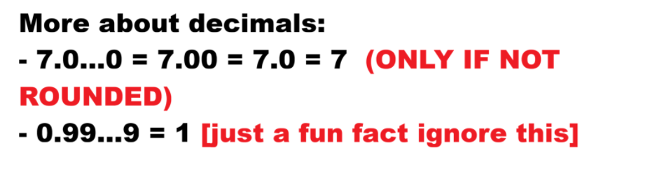

Slide 8
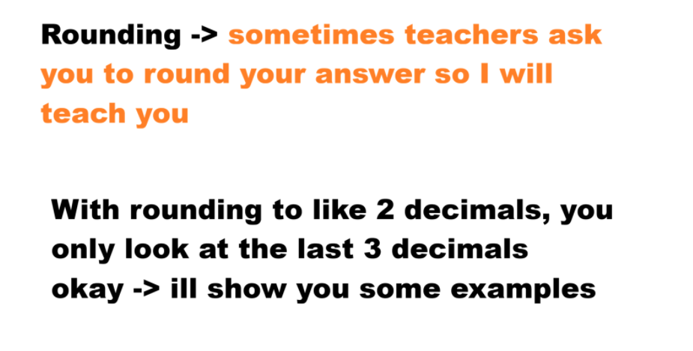

Slide 9
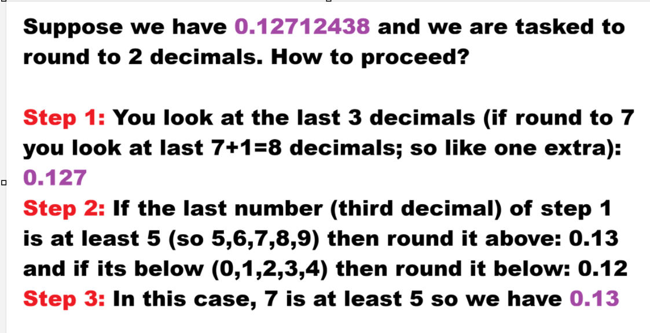

first

Slide 10
Suppose we have 23128555.415002 now (yes big number) and we have to round it to two decimals (=two numbers after comma/full stop) Dont worry friend! Same trick! Step 1: You look again at the first (2 [because round to 2 decimals] +1=) 3 decimals which are: 23128555.415 Step 2: The last number is at least 5 (in this case exactly 5), so we round it (make it two decimals like the question asked us to) to above Step 3: Therefore, we have as final answer 23128555.42 instead of 23128555.41 (which is if you round down)

Slide 11
